Slide 1

INTERNET OF THINGS

Slide 2
MODULE 1: INTRODUCTION
M2M Communication, IoT, M2M value chain, IoT value chain, an emerging industrial structure for IoT, Implications for IoT, Barriers and Concern, IoT use case example. [3 Hours]

Slide 3
Introduction
M2M and the IoT are two of the technologies that form the basis of the new world that we will come to inhabit.
The physical entities can be of any nature, such as buildings, farmland, and natural resources like air, and even such personal real-world concepts as my favorite hiking route through the forest or my route to work.
Starting off as ARPANET connecting remote computers together, the introduction of the TCP/IP protocol suite, and later the introduction of services like email and the World Wide Web (WWW), created a tremendous growth of usage and traffic.
The Internet has been evolving, another technology revolution has been unfolding the use of sensors, electronic tags, and actuators to digitally identify, observe and control objects in the physical world.
Rapidly decreasing costs of sensors and actuators have meant that where such components previously cost several Euros each, they are now a few cents.

Slide 4
M2M communication
M2M refers to those solutions that allow communication between devices of the same type and a specific application, all via wired or wireless communication networks.
M2M is deployed to achieve productivity gains, reduce costs, and increase safety or security.
M2M has been applied in many different scenarios, including the remote monitoring and control of enterprise assets, or to provide connectivity of remote machine-type devices.
M2M solutions do not generally allow for the broad sharing of data or connection of the devices in question directly to the Internet.

Slide 5
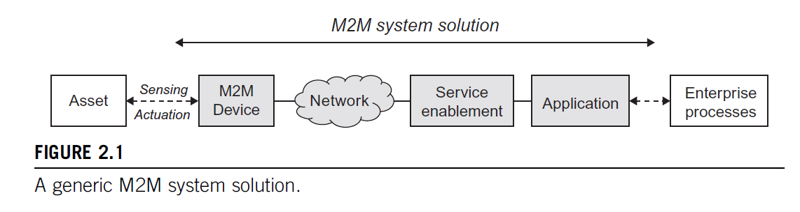
A typical M2M system solution consists of M2M devices, communication networks that provide remote connectivity for the devices, service enablement and application logic, and integration of the M2M application.

Slide 6
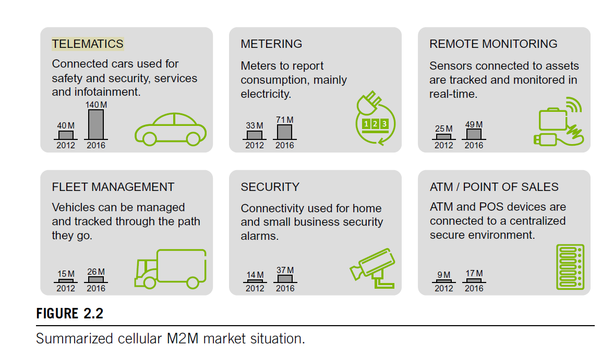

Slide 7
IOT
The IoT is a widely used term for a set of technologies, systems, and design principles associated with the emerging wave of Internet-connected things that are based on the physical environment.
IoT also refers to the connection of such systems and sensors to the broader Internet, as well as the use of general Internet technologies.
No longer will the Internet be only about people, media, and content, but it will also include all real-world assets as intelligent creatures exchanging information, interacting with people, supporting business processes of enterprises, and creating knowledge.

Slide 8
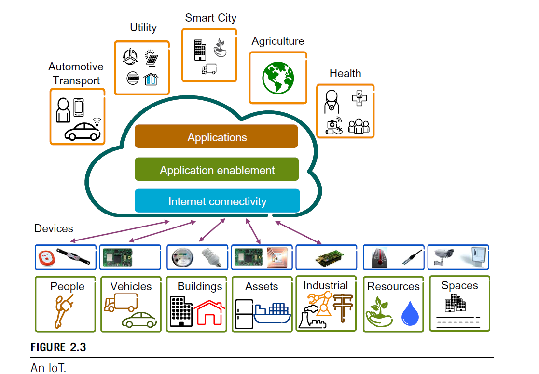

Slide 9
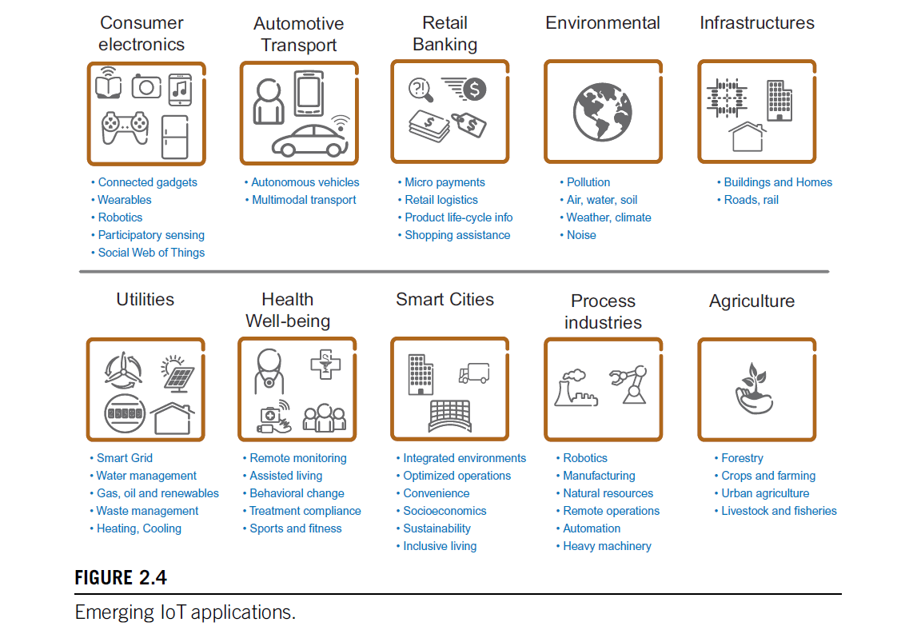

Slide 10
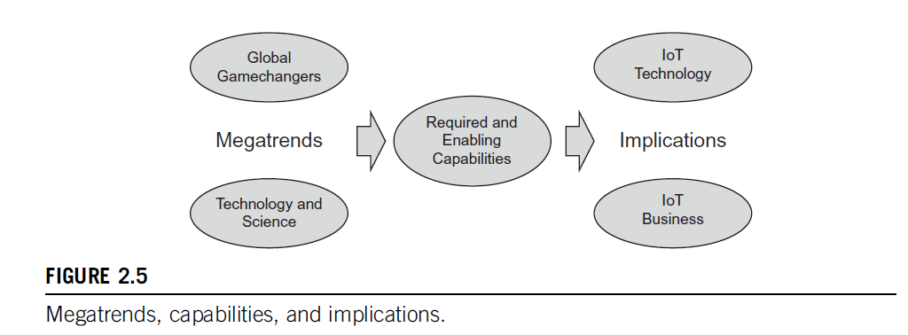

Slide 11
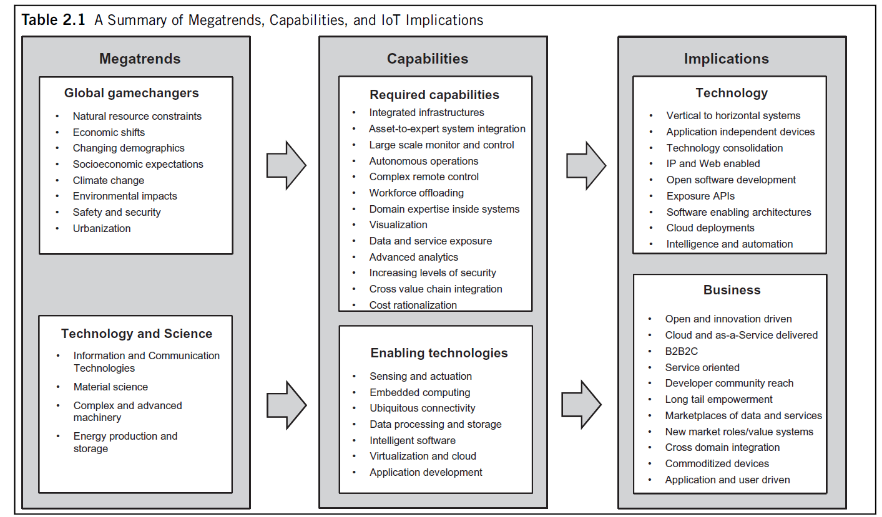

Slide 12
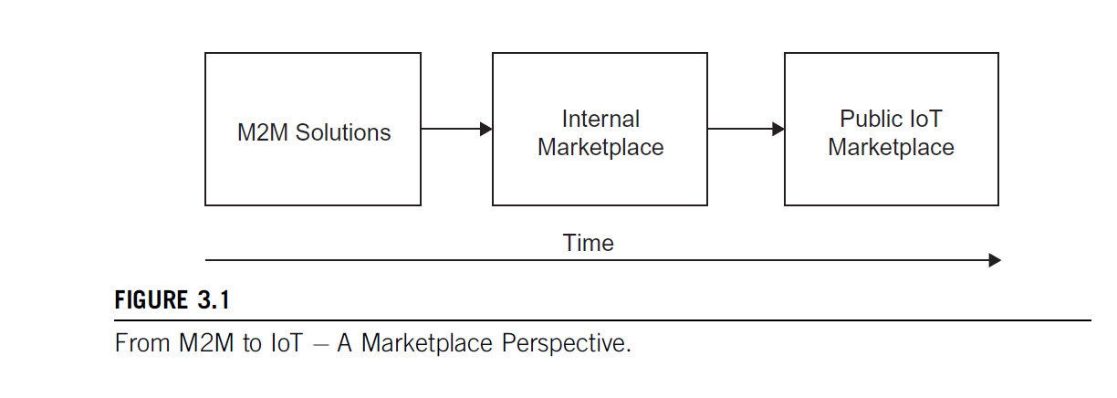
M2M value chain

Slide 13
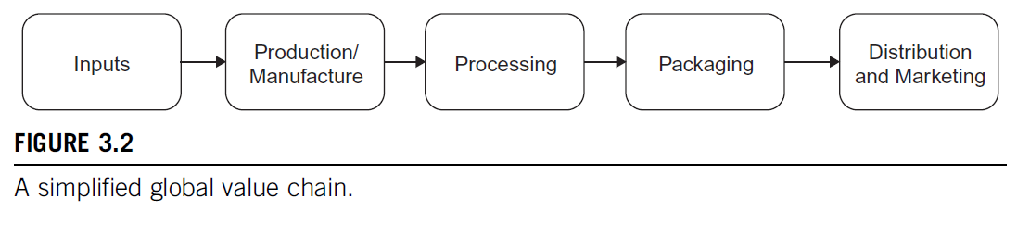
VALUE CHAIN
A value chain describes the full range of activities that firms and workers perform to bring a product from its conception to end use and beyond, including design, production, marketing, distribution, and support to the final consumer.

Slide 14
Reasons for using M2M vary from project to project and company to company but can include things such as cost reductions through streamlined business processes, product quality improvements, and increased health and safety protection for employees.
Inputs: Inputs are the base raw ingredients that are turned into a product.
Examples could be cocoa beans for the manufacture of chocolate
2. Production/Manufacture: Production/Manufacture refers to the process that the raw inputs are put through to become part of a value chain.
For example, cocoa beans may be dried and separated before being transported to overseas markets.
Data from an M2M solution, meanwhile, needs to be verified and tagged for provenance.

Slide 15
3. Processing: Processing refers to the process whereby a product is prepared for sale.
For example, cocoa beans may now be made into cocoa powder, ready for use in chocolate bars.
For an M2M solution, this refers to the aggregation of multiple data sources to create information component.
4. Packaging: Packaging refers to the process whereby a product can be branded as would be recognizable to end-user consumers.
For example, a chocolate bar would now be ready to eat and have a red wrapper with the words “KitKatt” on it.

Slide 16
5. Distribution/Marketing: This process refers to the channels to market for products.
For example, a chocolate bar may be sold at a supermarket, a kiosk, or even online.
M2M value chains are internal to one company and cover one solution. IoT Value Chains, meanwhile, are about the use and reuse of data across value chains and across solutions.

Slide 17
IoT value chains
The move towards IoT - from a value creation perspective - comes with the desire to make some of the data from sensors publicly available as part of an “information marketplace” or other data exchange that allows the data to be used by a broader range of actors rather than just the company that the system was originally designed for.
IoT value chains based on data are to some extent enabled by Open APIs and other open web-based technologies.

Slide 18
The cognitive and conceptual human skills that were first embedded in semiconductors during the 1950s and 1960s are now decoupled from the specific technological system that was developed to house them. It is this decoupling of technology systems that allows for the creation of information marketplaces.
This can initially make the value chain of an IoT solution look significantly more complex than one for a traditional product such as chocolate, but the principles remain the same.
Let’s take a closer look at a possible IoT value chain, including an Information Marketplace, illustrated in Figure 3.3.

Slide 19
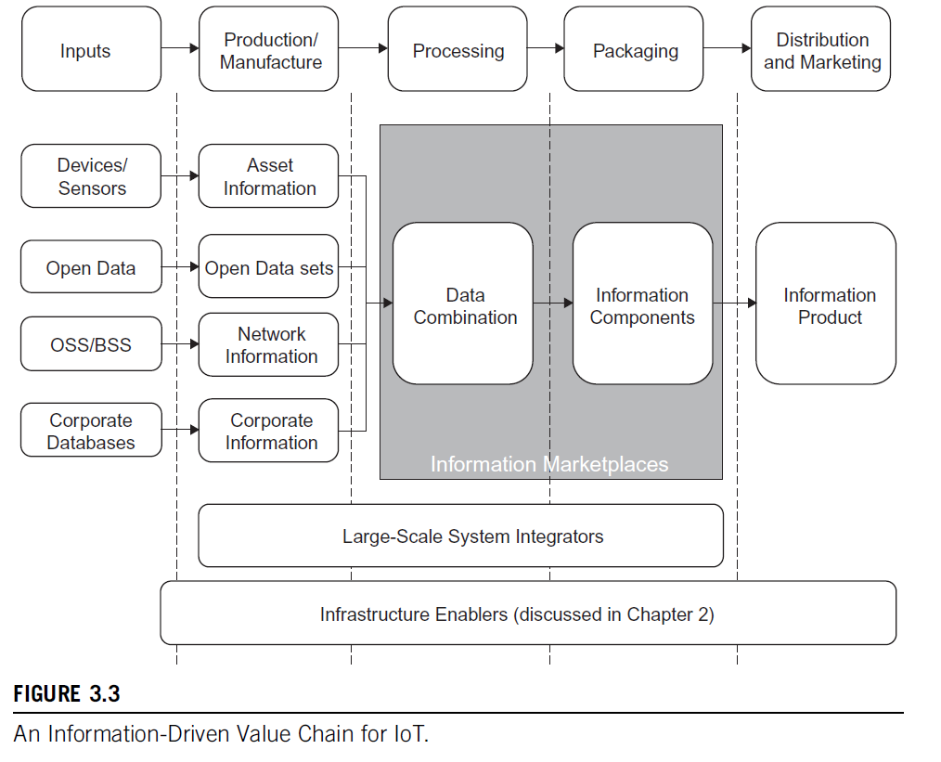

Slide 20
Inputs: The first thing that is apparent for an IoT value chain is that there are significantly more inputs than for an M2M solution.
• Devices/Sensors: these are very similar to the M2M solution devices and sensors, and may in fact be built on the same technology.
• Open Data: Open data is an increasingly important input to Information Value Chains. A broad definition of open data defines it as: “A piece of data is open if anyone is free to use, reuse, and redistribute it – subject only, at most, to the requirement to attribute and/or share-alike” .
Within the context of this book, we refer to open data as those provided by government and city organizations. Examples include city maps, provided by organizations such as Ordinance Survey in the United Kingdom. Open data requires a license stating that it is open data.
• OSS/BSS: The Operational Support Systems and Business Support Systems of mobile operator networks are also important inputs to information value chains, and are being used increasingly in tightly closed information marketplaces that allow operators to deliver services to enterprises
for example, where phone usage data is already owned by the company in question.
• Corporate Databases: Companies of a certain size generally have multiple corporate databases covering various functions, including supply chain management, payroll, accounting, etc. . . . Over the last decades, many of these databases within corporations have been increasingly interconnected using Internet Protocol (IP) technologies.

Slide 21
Production/Manufacture: In the production and manufacturing processes for data in an IoT solution, the raw inputs described above will undergo initial development into information components and products.
Irrespective of the input type described above, this process will need to include tagging and linking of relevant data items in order to provide provenance and traceability across the information value chain.
Some examples, as illustrated in Figure 3.3, are as follows:
• Asset Information: Asset information may include data such as temperature over time of container during transit or air quality during a particular month. Essentially, this relates to whatever the sensor/device has been developed to monitor.
• Open Data Sets: Open data sets may include maps, rail timetables, or demographics about a certain area in a country or city.
• Network Information: Network information relates to information such as GPS data, services accessed via the mobile network, etc. . . .
• Corporate Information: Corporate information may be, for example, the current state of demand for a particular product in the supply chain at a particular moment in time.

Slide 22
Processing: During the processing stage, data from various sources is mixed together.
At this point, the data from the various inputs from the production and manufacturing stages are combined together to create information.
This process involves the extensive use of data analytics for M2M and IoT solutions.
Packaging: After the data from various inputs has been combined together, the packaging section of the information value chain creates information components.
These components could be produced as charts or other traditional methods of communicating information to end-users.
In addition, however, they could be fed into knowledge management frameworks (discussed in Chapter 5) in order to create not just visualizations of existing information, but to create new knowledge for the enterprise in question.

Slide 23
Distribution/Marketing: The final stage of the Information Value Chain is the creation of an Information Product. A broad variety of such products may exist, but they fall into two main categories:
• Information products for improving internal decision-making: These information products are the result of either detailed information analysis that allows better decisions to be made during various internal corporate processes, or enable the creation of previously unavailable knowledge about a company’s products, strategy, or internal processes.
• Information products for resale to other economic actors: These information products have high value for other economic actors and can be sold to them. For example, through an IoT solution, a company may have market information about a certain area of town that another entity might pay for (e.g. a real-estate company).

Slide 24
An emerging industrial structure for IoT
M2M and IoT are about rapidly integrating data and workflows that form the basis of the global economy at increasing speed and precision.
Combined, these two technologies create a platform that will rapidly redefine the global economy.
A new form of value chain is emerging as a result - one driven by the creation of information, rather than physical products.

Slide 25
For IoT, however, new sets of system integrator capacity are required for two main reasons:
Technical:
The factors driving the technical revolution of these industries mean that the complexity of the devices in question requires massive amounts of R&D; as do semiconductors with large amounts of functionality built into the silicon.
Services will require multiple devices, sensors, and actuators from suppliers to be integrated and exposed to developers.
Only those companies with sufficient scale to understand the huge number of technologies well enough to integrate them fully on behalf of a customer can handle this technical complexity.

Slide 26
2. Financial:
Only those companies that can capture the added value created in the emerging industrial structure will recoup enough money to re-invest in the R&D required to participate in the systems integration market.
It is highly likely that the participants who do not capture part of the integration market will be relegated to “lower” ends of the value chain, producing components as input for other system integrators.

Slide 27
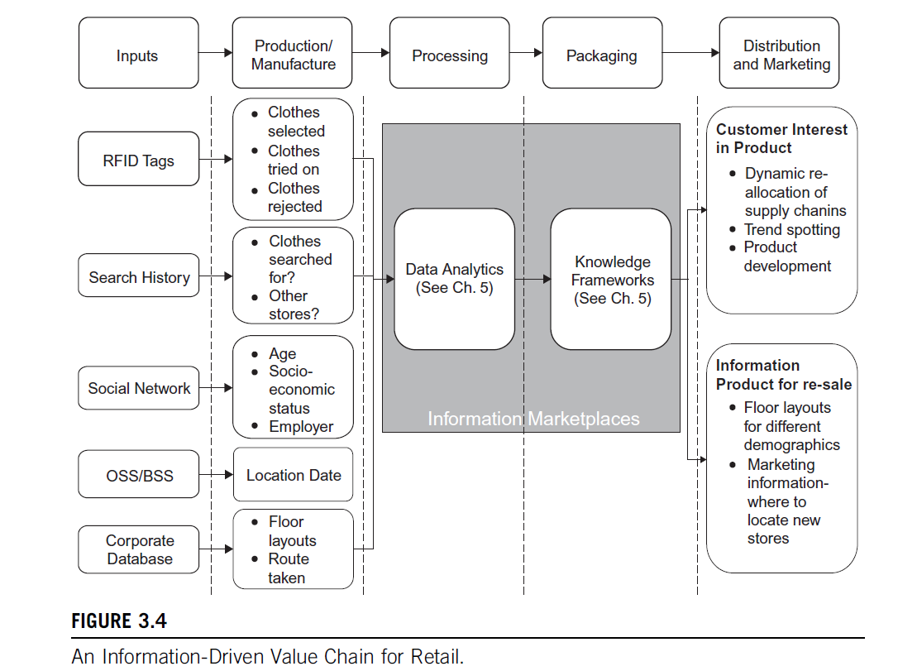

Slide 28
The information-driven global value chain
There are five fundamental roles within the I-GVC that companies and
other actors are forming around, illustrated in Figure 3.5:
Inputs:
Sensors, RFID, and other devices.
End-Users.
Data Factories.
Service Providers/Data Wholesalers.
Intermediaries.
Resellers

Slide 29
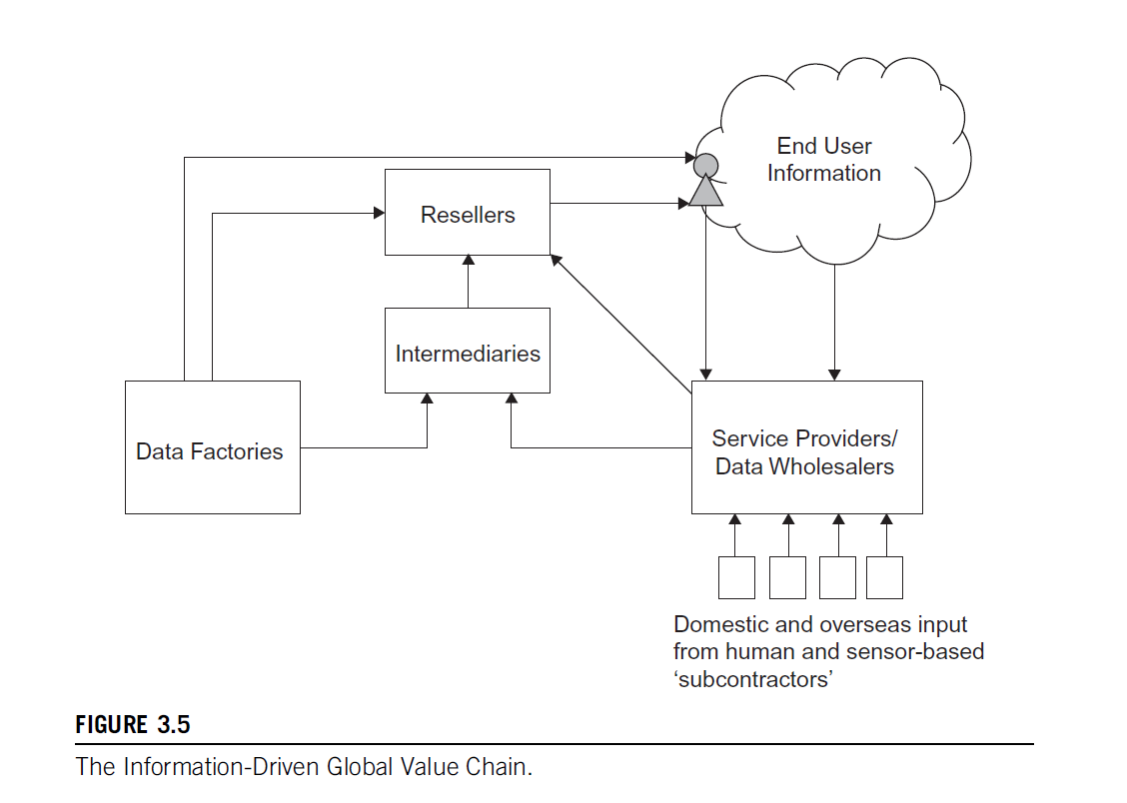

Slide 30
Components
Data Factories
These entities produce raw data.
Intermediaries
They process, refine, and add value to the data received from data factories.
Resellers
They purchase data from intermediaries and sell it to other entities, including service providers and end users.
Service Providers/Data Wholesalers
These entities aggregate data from various sources, including intermediaries and resellers, and provide comprehensive data services to end users.
They receive input from domestic and overseas sources, both human and sensor-based subcontractors.
End User Information
This represents the final stage where data is utilized by end users, which could include businesses, organizations, or individual consumers.

Slide 31
Implications for IoT
The evolution of technology is driving a shift from vertical, application-specific systems to horizontal, application-independent systems.
This trend is evident in standardization efforts by ETSI M2M and oneM2M, and the adoption of the TCP/IP stack for IoT devices by organizations like the IETF and IPSO Alliance.
In M2M, there is a move towards consolidating technologies across industry segments that previously relied on proprietary solutions. This shift promotes interoperability and reduces the variety of technologies and protocols needed.
As IoT applications require greater flexibility, there is a transition from application-specific devices to those that can be used in various applications, leveraging web services for easier integration and broader developer engagement.
While M2M has traditionally focused on devices and connectivity, the focus for IoT is moving towards services, data, and intelligence.

Slide 32
Barriers and Concern
Key issues include:
Privacy and Personal Integrity: The widespread use of RFID tags and sensors, including in smartphones, can lead to extensive data collection, raising concerns about privacy and profiling.
Data Reliability and Accuracy: With numerous data sources from different providers, ensuring data quality and provenance is crucial to avoid reliance on inaccurate or faulty information, which affects accountability and liability.
Security: IoT introduces cyber-physical security concerns, where the potential for real-world damage to property and people’s safety becomes significant.
Cost: The costs of deploying IoT devices involve not just capital expenditure (CAPEX) but also operational expenditure (OPEX). There is a need for highly automated provisioning and zero-configuration to manage these costs effectively, including contextual information like location.

Slide 33
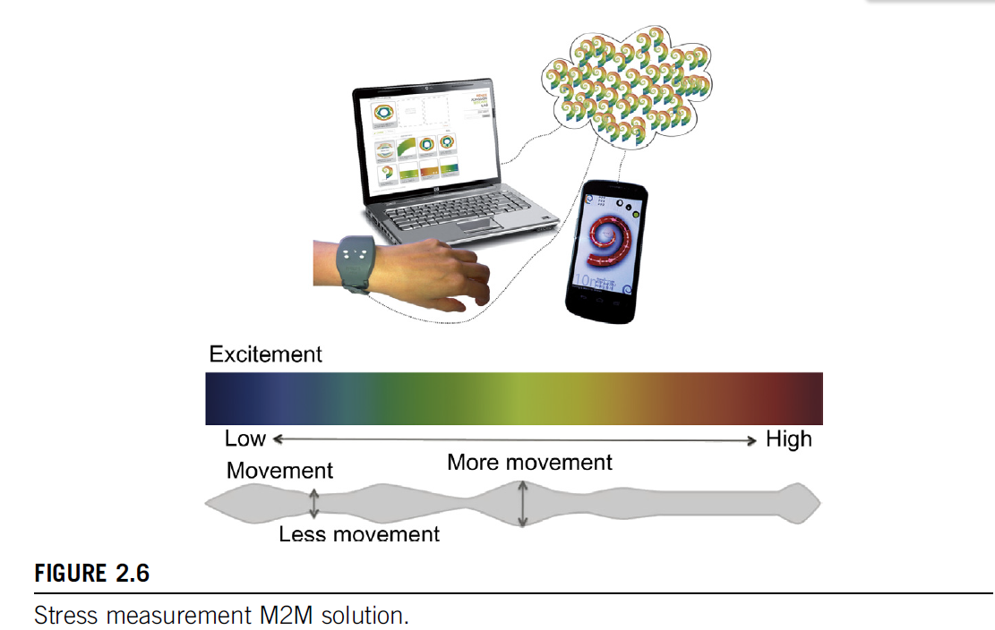
IoT use case example

Slide 34
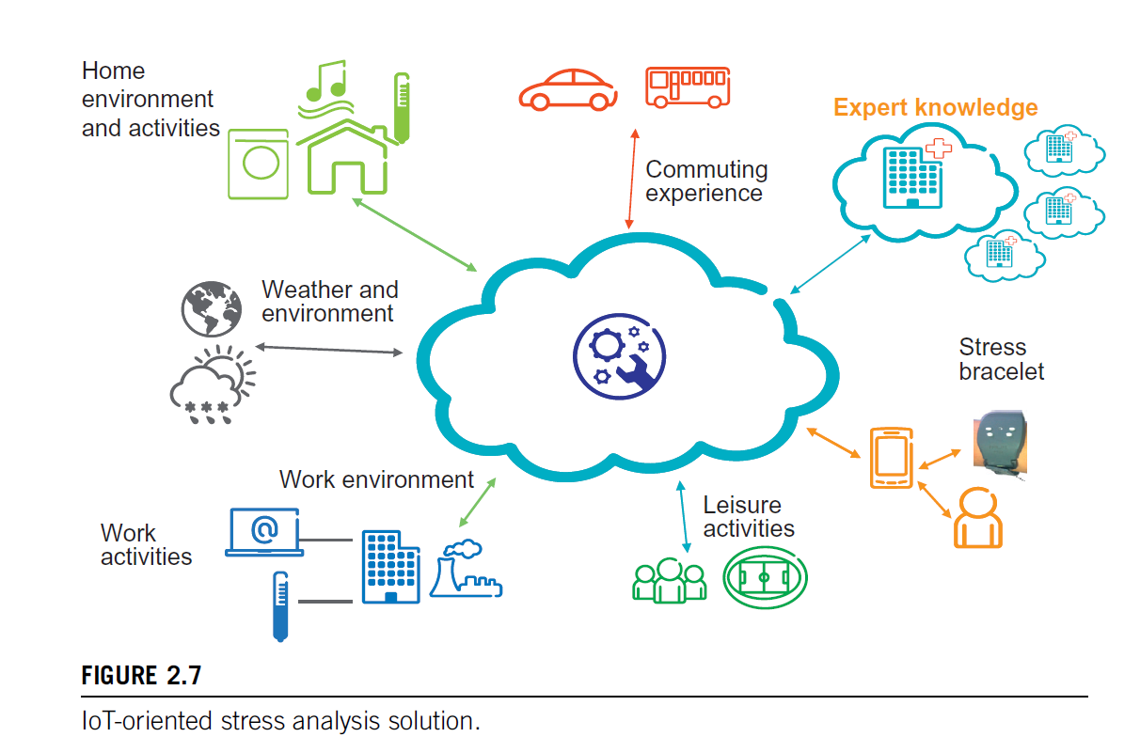

Slide 35
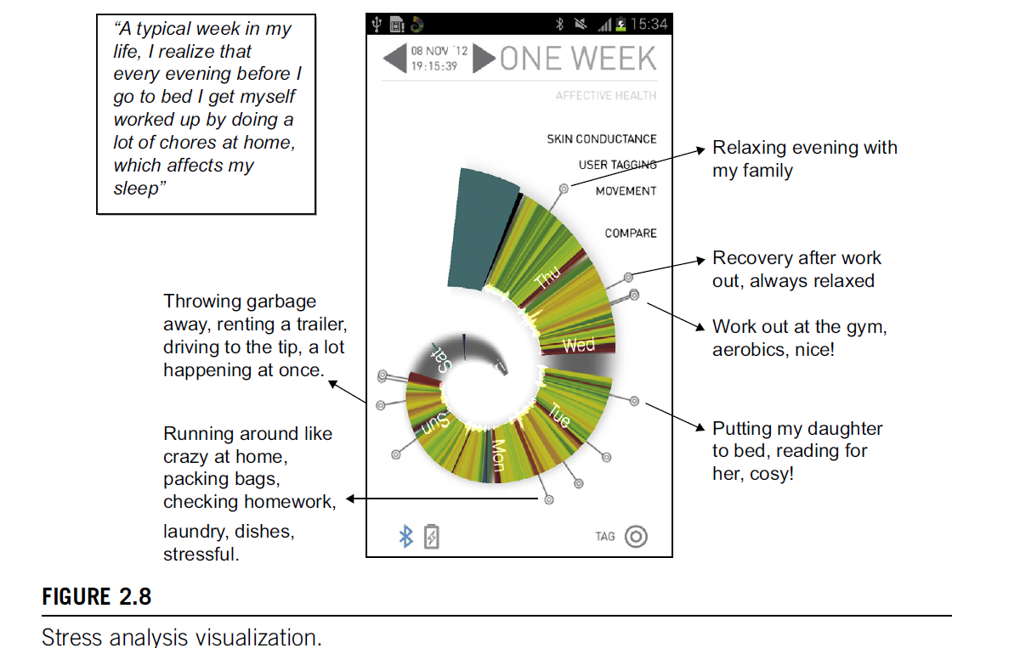

Slide 36
THANK YOU

